Slide 1


FOUNDATIONS OF DATA ANALYTICS
Lawrence Gray, PhD
Head of Data Science, KPMG Spark
Adjunct Faculty, Georgetown University

Slide 2
CONTENTS
1
What is data and where does it come from?
1
Types of Data Analytics
2
What is Data Analytics?
2
What is the role of the Data ?
3
Explain the importance of Data Analytics in today's economy.
3
Typical Data Analyst Responsibilities
4
Discuss how data can be used to inform data-driven decision making

Slide 3

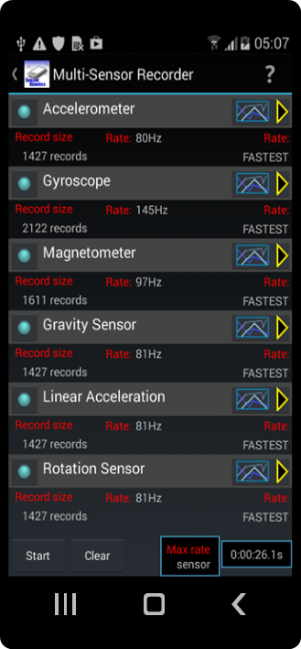
WHY IS DATA IMPORTANT?
‘New oil’ of the global economy
Significant/critical corporate asset
Data is everywhere
Demo: Sensor Kinetics App

Slide 4

WHAT IS DATA?
Data can be qualitative or quantitative.
Qualitative data is descriptive information (it describes something)
Quantitative data is numerical information (numbers)
Discrete data can only take certain values (like whole numbers)
Continuous data can take any value (within a range)
Put simply: Discrete data is counted, Continuous data is measured
Description
Data is a collection of facts, such as numbers, words, measurements, observations or just descriptions of things.

Slide 5


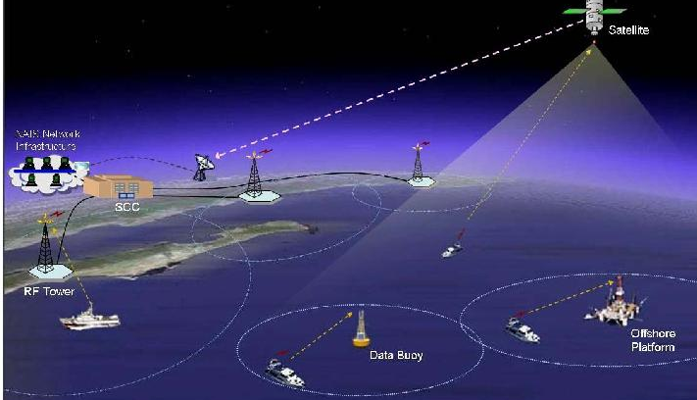
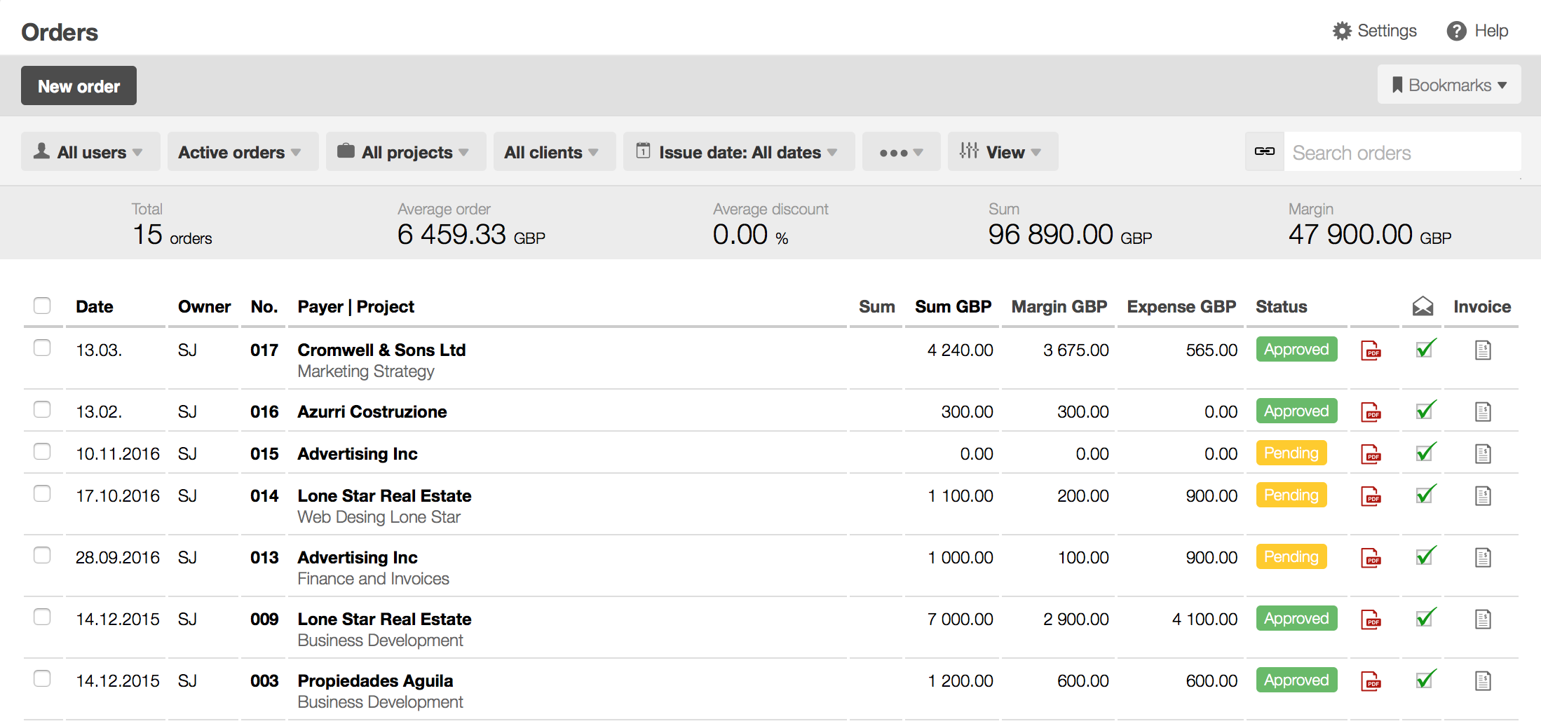
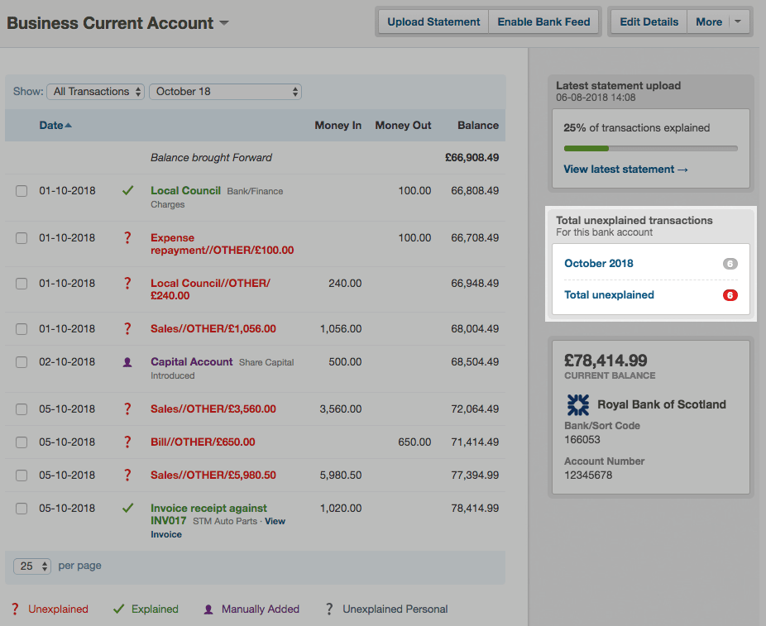
TYPES OF DATA

Slide 6

WHAT IS DATA ANALYTICS?
The process of examining datasets to draw conclusions about the information they contain. Data analytic techniques enable you to take raw data and uncover patterns to extract valuable insights from it.
Analyzing big data can optimize efficiency in many different industries. Improving performance enables businesses to succeed in an increasingly competitive world. Data analytics is being used with great success in a number of different fields.

Slide 7

THE IMPORTANCE OF DATA ANALYTICS IN TODAY'S ECONOMY
Optimize Performance
Make better business decisions – that can lead to new –and better – products and services

Slide 8




DATA DRIVEN DECISIONS MAKING
Know Your
Mission
Identify Data Sources
Clean and Organize Data
Perform Statistical Analysis
Draw Conclusions

Slide 9
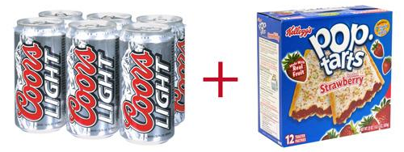
DATA DRIVEN DECISIONS MAKING - Walmart
Question
What do people buy before a big storm?
How do we supply stores ahead of future storms?
Decision
The retailer began sending trucks loaded with these items to stores in areas where hurricanes were forecast, and sales were brisk
Data
Product Purchasing Data
Results
7-Fold Increase in Strawberry Pop-Tarts sales
Top-selling item was Beer

Slide 10
DATA DRIVEN DECISIONS MAKING - BUCO
BUCO – a hardware retailer with 46 locations across South Africa,
Question
Are men or women were their most frequent customers?
Which locations had the most loyal customers, and from what suburbs the most valuable customers to a given store were coming.
Data
Came from “Nedbank” – BUCO’s Bank
Amassed a treasure trove of transactional data it could share with merchants:
The type of card being used, the time of the transaction, the size of the purchase, the retailer, the location
Customer’s age, gender, race, marital status, and income bracket
Results/
Decisions
At certain location most of business was not derived from local residents that, in fact, half of his business was coming from residents that lived in a town 10 kilometers away,
At certain locations, a large portion of our clientele was female, so we introduced a Saturday craft workshop featuring chalk paint

Slide 11
TYPES OF DATA ANALYTICS
Descriptive
Explains what happened.
Describing or summarizing the existing data using data analytic tools to better understand what is going on or what has happened.
Predictive
Forecasts what might happen.
Emphasizes on predicting the possible outcome using statistical models and machine learning techniques.
Prescriptive
Recommends an action based on the forecast.
It is a type of predictive analytics that is used to recommend one or more course of action on analyzing the data.
Diagnostic
Explains why it happened.
Focus on past performance to determine what happened and why.
Notes:
Descriptive
Simplest form of analytics
Purpose: Summarize findings and understand what’s going on
Involves:
wrangling data into understandable chunks
descriptions based on aggregations of past performance
Diagnostic
Why something happened in the past
Looks for root causes of the events
Factors/Events that contributed to outcome
Predictive
Predict future outcomes
Built on preliminary descriptive analytics
Involves:
Devising models that extrapolate from data the future occurrence of events
Machine learning and relies on existing data
Prescriptive
Suggest future solutions
Uses feedback system to constantly learn and update relationship between the action and the outcome
Suggests outcomes for specified course of action or a particular outcome

Slide 12

WHAT IS THE ROLE OF A DATA ANALYST?
Data analysts work with data to help their organizations make better business decisions
Most in-demand Skills
Python
Databases
Statistical Analysis
Data Visualization (including Tableau)

Slide 13

TYPICAL DATA ANALYST RESPONSIBILITIES
Preparing and Analyzing Data
Create reports and data visualizations
Data Acquisition
Managing data in databases
Finding and Interpreting trends in complex data sets
Collaborating with stakeholders to achieve business objectives

Slide 14
LIFE CYCLE OF A DATA ANALYSIS PROJECT

Slide 15

Business Issue
Understanding
Step 1
Define business objectives
Gather required information
Determine appropriate analysis method
Clarify scope of work
Identify deliverables

Slide 16

Data
Understanding
Step 2
Collect initial data
Identify data requirements
Determine data availability
Explore data and characteristics

Slide 17

Data
Preparation
Step 3
Gather data from multiple sources
Cleanse
Format
Blend
Sample

Slide 18
Exploratory Analysis And Modeling
Step 4
Develop methodology
Determine important variables
Build model
Assess model

Slide 19

Validation
Step 5
Evaluate results
Review process
Determine next steps
If results are valid, proceed to step 6
If results are invalid, revisit steps 1-4

Slide 20

Visualization and Presentation
Step 6
Communicate results
Determine the best method to present insights based on analysis and audience
Craft a compelling story
Make recommendations

Slide 21
THANK
YOU!
Lawrence Gray, PhD
Head of Data Science, KPMG Spark
Adjunct Faculty, Georgetown University

